Slide 1
SMART CITIES

Slide 2
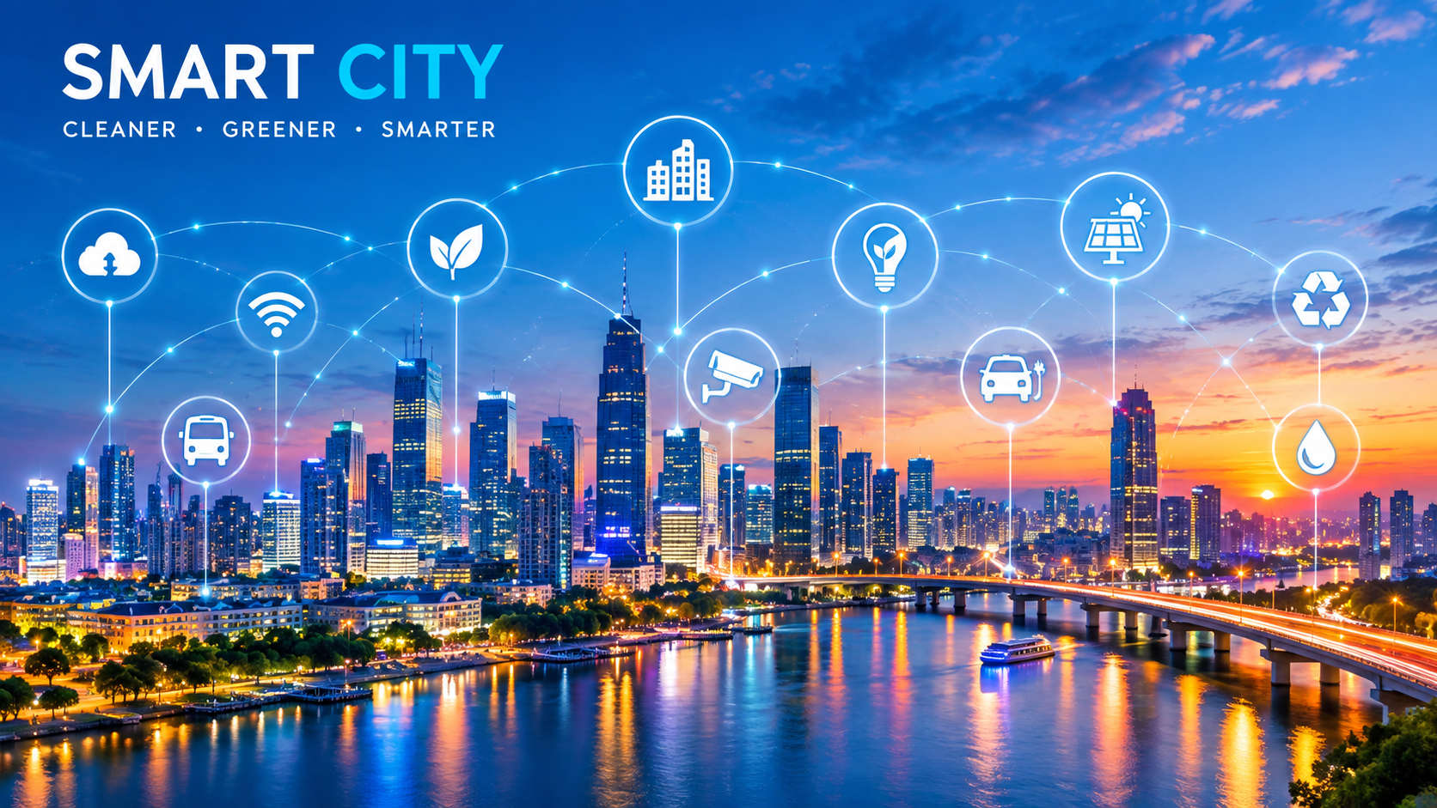
Introduction to Smart Cities
A smart city is an urban area that uses digital technologies, communication networks, and data-driven solutions to improve the quality of life of its citizens. It aims to make city services more efficient, sustainable, and responsive by integrating technology into infrastructure, transportation, energy, healthcare, and governance.

Slide 3
Evolution of Urban Devlopment
Cities have evolved from traditional settlements to modern urban centre. With rapid population growth and technological advancements, cities face challenges such as traffic congestion, pollution, and resource scarcity. Smart cities emerged as a solution to address these issues through innovation and intelligent management systems.

Slide 4
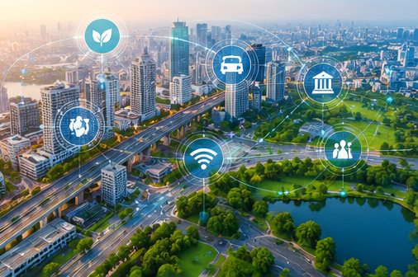
Components of Smart Cities
Smart Governce
Smart Transportation
Smart Energy
Smart Healthcare
Smart Education
Smart Water Management

Slide 5
Characteristics of Smart Cities
1. Technology-driven infrastructure
2. Efficient resource utilization
3. Sustainable development
4. Citizen participation
5. Data-driven decision making
6. Improved public services

Slide 6
Technologies Used in Smart Cities
Internet of Things (IoT)
Artificial Intelligence (AI)
Big Data Analytics
Cloud Computing
5G Networks
Blockchain Technology

Slide 7
Challenges of Smart Cities
Cities have evolved from traditional settlements to modern urban centre. With rapid population growth and technological advancements, cities face challenges such as traffic congestion, pollution, and resource scarcity. Smart
cities emerged as a solution to address these issues through innovation and intelligent management systems.

Slide 8
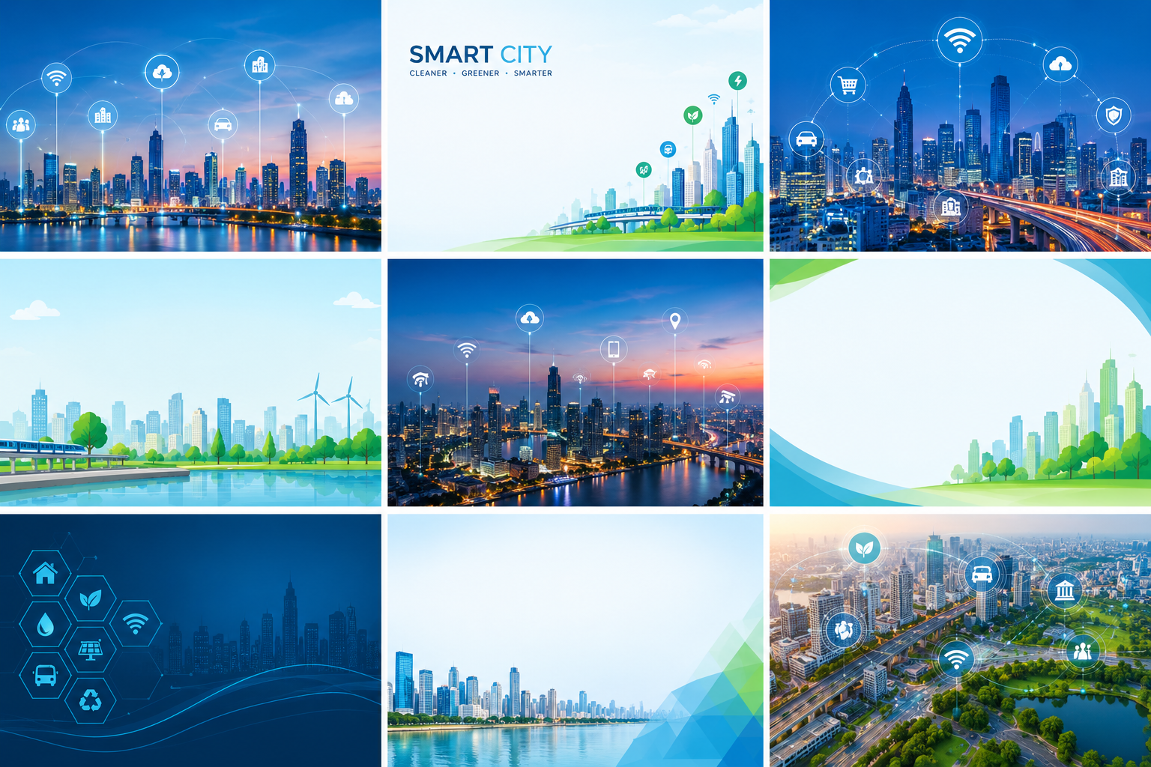
Benefits of Smart Cities
Improved quality of life
Better public services
Sustainable development
Reduced pollution
Enhanced safety and security
Efficient use of resources
Economic growth opportunities

Slide 9
THANK YOU

